Slide 1
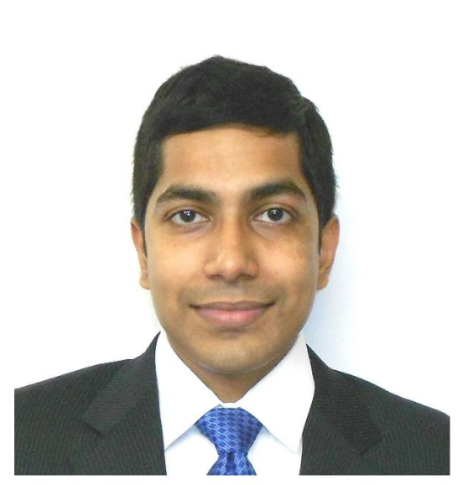
Intro to GANs
Generative Adversarial Networks
Jayanth Rasamsetti
Founder & Chief Scientist
www.sgmoid.com
Columbia University (MS)
IIT Madras (B.Tech & M.Tech)
jr3281@columbia.edu
https://www.linkedin.com/in/jayanthr/

Slide 2
Agenda:
Google Colaboratory - GPU, AWS Sagemaker
First Half: A refresher on CNN, Resnet 18, VGG 19, Neural Networks workings, GANs
Second Half: DCGANs, Cycle GANs
Test

Slide 3
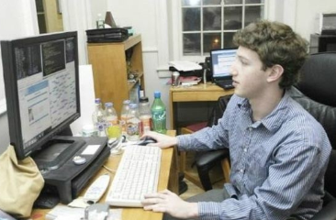
Best Practices:
We will be very hands on! Blend of theory & lab
Very important to code every day 20 lines of Python code
Introduction to Google Colab (https://colab.research.google.com/notebook)
De-bug as much as possible every line of code
10 min rule: Try to debug for 10 min independently (either stack overflow, etc) and only then seek help (from a peer)
Tips to improve coding: Pair programming, long hours, competitions
Avoid copy pasting!

Slide 4

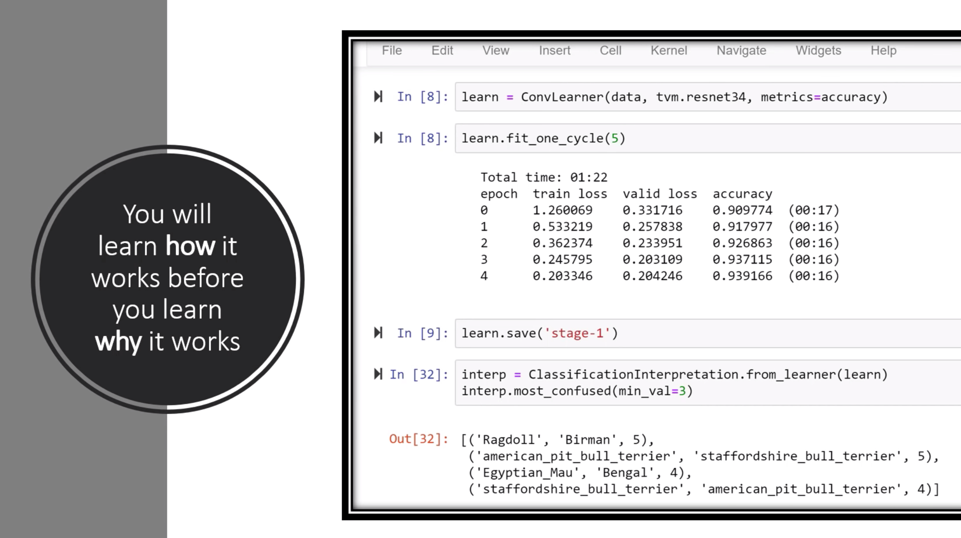
Case Method Style of teaching:
Traditional Method:
Concept > Exercise
Pros: Linear Flow
Cons: Dependent thinking, Fallacy in
structure
Case Study > Solve Exercise
Pros: Independent thinking, Research,
similar to most real life problems
Failing is good! Independent problem
solving is better!
Fail fast! Iterate faster! Debug faster!

Slide 5
Debug Checklist:
Spelling mistakes
Case sensitive, Parenthesis ( { [
Correct path to the dataset
Input libraries
Variable names
Indentation
Syntax
Shape mismatch
Type mismatch (numpy arrays)
Stackoverflow
Prerequisite: ML, Python

Slide 6
Debug Checklist:
Follow the checklist to the letter
Look at the line number where the code broke
Search appropriately in Google the error
Look at stackoverflow, most people have similar errors
Read highly voted Stackoverflow comments only
Outcomes:
Atleast 30 lines of Python code/day. Debugged 10 errors. Independently.
Basic + Bonus. Outline of Machine Learning.
Positive Frame of mind and ready for the next steps (Decision Trees, Random Forests, Neural Networks)
Competitive Coding (Kaggle); Academic Research (IISc/IIIT/PGSSP), Startup
Survey Link towards the end

Slide 7
Agenda
What do you mean by Generative Models?
What are GANs?
Deep Convolutional GANs (DCGAN)
Conditional GANs
How to train GANs?
Applications
Semi-Supervised Learning
Q&A

Slide 8
Generative Models
So Far we are trying to solve these problems?
Predict the Price of a Car
Classify Dogs and Cats
Predict whether it will Rain or Not?
Whose Face is it?
These all are Discriminative Models.

Slide 9
Generative Models
Price of a Car
Classify Dogs /Cats
Will it Rain or Not?
Whose Face is it?
1. What is a Car?
2. What is a Dog or Cat?
3. What is Rain?
4. What is Face?
Discriminative Model
Generative Model

Slide 10
Discriminative Models vs Generative Model in Math
What are we trying to solve?
A (input) | B (target)
0 | 1
1 | 0
1 | 1
P(A/B)
Probability of A given B
P(A,B)
Joint Probability Distribution on A× B
0 | 0
Discriminative Models
Generative Model

Slide 11
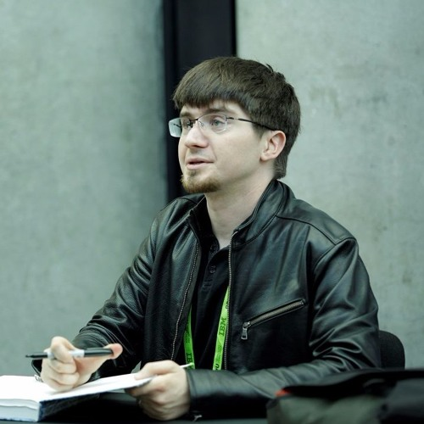
Who invented it?
IAN Goodfellow in 2014
Called as Father of GANs

Slide 12
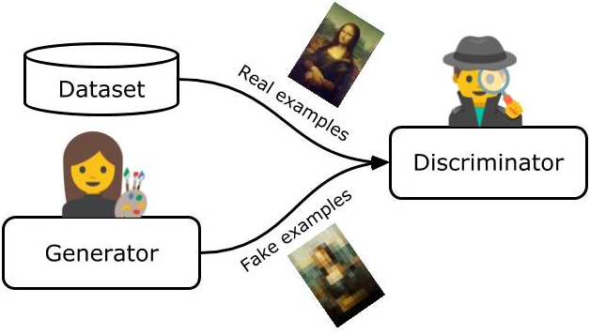
What are GANs?
An art forger (the “Generator”) trying to
fool an art expert (the “Discriminator”).
The more convincing the fake paintings
the forger makes, the better the art
expert needs to be at determining
their authenticity and vice versa.

Slide 13
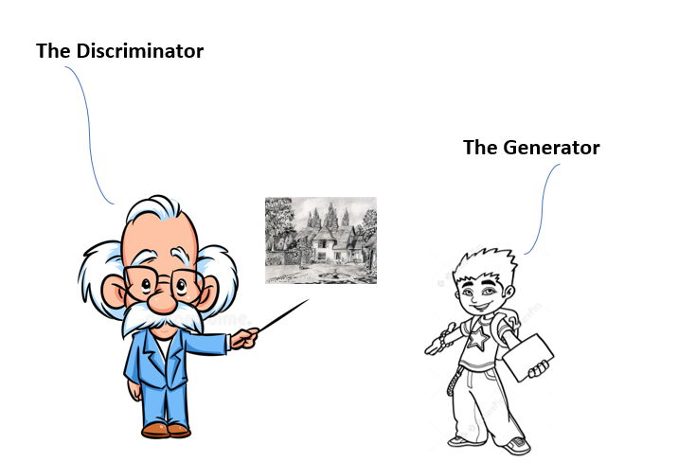
What are GANs? Another examples
A teacher keeps on giving feed
back until student create a
perfect picture so that teacher
Can't differentiate between the
Original picture and the one
Created by student.

Slide 14
GANs
The word “generative” indicates the overall purpose of the model: creating new data. The data that a GAN will learn to generate depends on the choice of the training set—for example, if we want a GAN to paint like Leonardo da Vinci, we would use a training dataset of Leonardo’s artwork.
The term “adversarial” points to the game-like, competitive dynamic between two algorithms that constitute the GAN framework.
The Generator and the Discriminator. The Generator’s goal is to create examples that are indistinguishable from the real data in the training set.

Slide 15
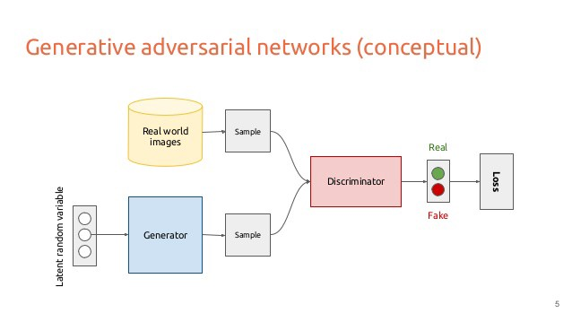
Architecture

Slide 16
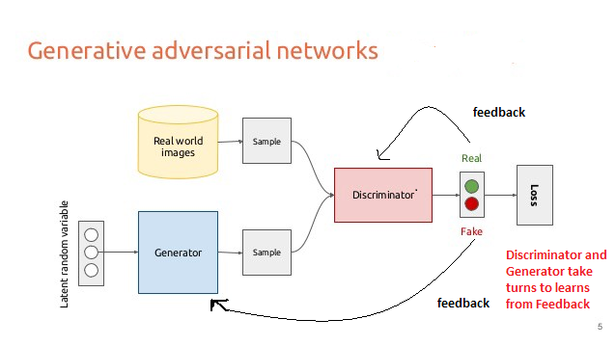
How Discriminator and Generator learns?

Slide 17
Deep Convolutional GAN (DCGAN)
DCGANs uses Convolution Neural Networks (CNNs) to build generator and discriminator
What is Noise or random numbers? - (Input to Generator)
What is Fake data? - (Any type of data which we want Generator to create eg image of a face)

Slide 18
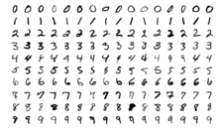
DCGANs of MNIST

Slide 19
Input and Output of Generator for MNIST
Generator
Noise
(100 random numbers)
Fake Image
(Image of size (28,28,1))

Slide 20
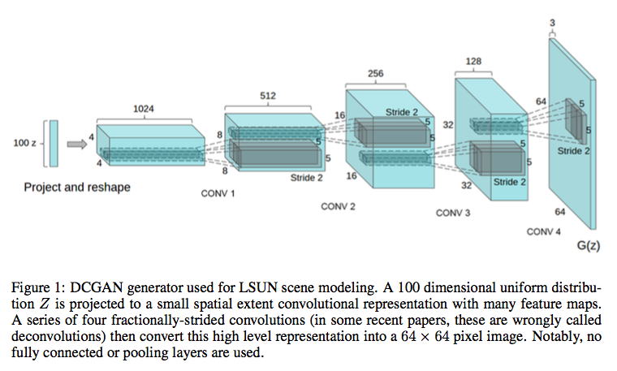
DCGAN Generator
https://medium.com/@lisulimowicz/dcgan-79af14a1c247

Slide 21
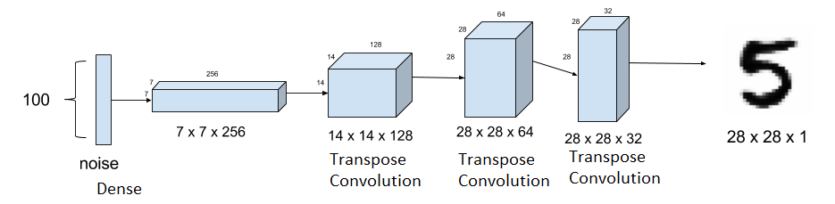
DCGAN Generator Simplified

Slide 22
What methods do we already know to extrapolate missing data?

Slide 23
What methods do we already know to extrapolate missing data?
Nearest neighbour interpolation
Central Tendency (mean, mode, median, etc)
But these are hard coded, not learnt. Are there ways we can learn to extrapolate missing data?
Transpose Convolution or Deconvolution

Slide 24
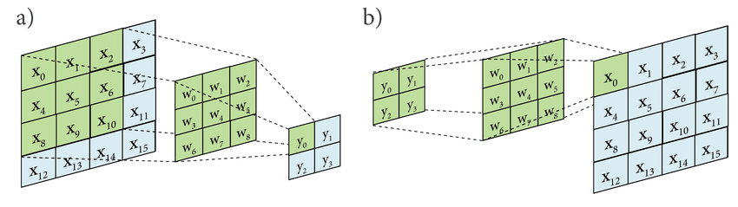
What is Transpose Convolution?
a ) -Traditional Convolution
b) - Transpose Convolution

Slide 25
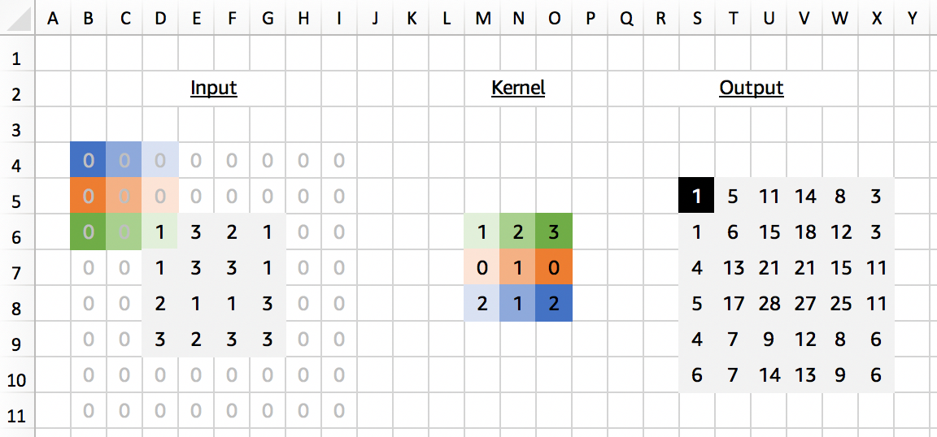
What is Transpose Convolution?
A Conv2DTranspose with 3x3 kernel applied to a 4x4 input to give a 6x6 output. Surprisingly the padding for Conv2DTranspose is set to 0 in this example, even though implicit padding is seen.
Credits - https://medium.com/apache-mxnet/transposed-convolutions-explained-with-ms-excel-52d13030c7e8

Slide 26
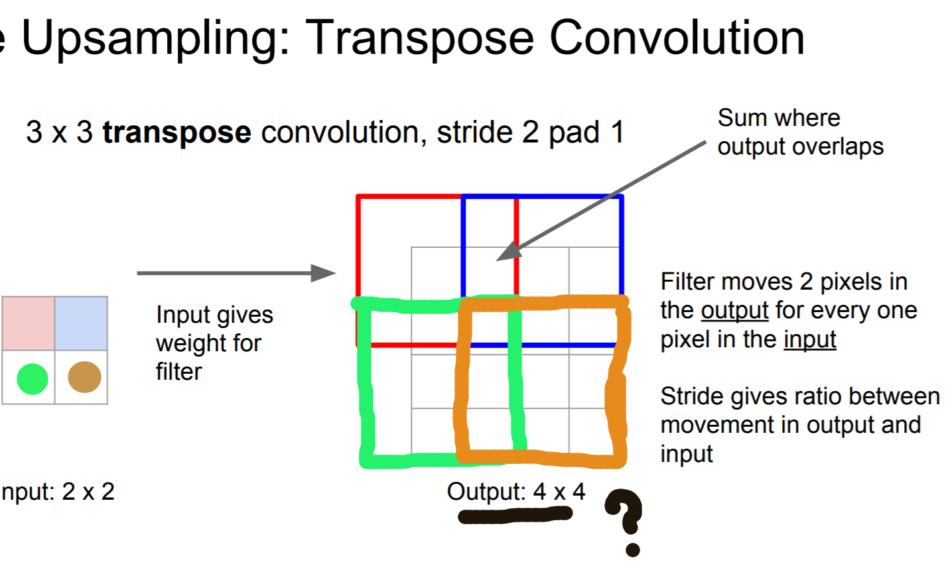
Question?
What happens to overlapping
region?
Ans - Added together.
FYI — the transposed convolution is also known as: Fractionally-strided convolution Deconvolution

Slide 27
DCGAN Discriminator
Real Images from MNIST
Discriminator
Real or Fake?
Fake images MNIST created by generator
Discriminator will take both
fake and real images as
input and ...classify them as
Real OR Fake

Slide 28
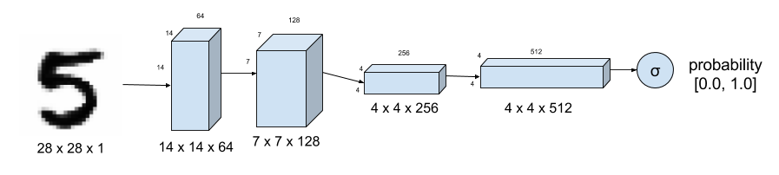
Discriminator DCGAN
Discriminator of DCGAN tells how real an input image of a digit is. MNIST Dataset is used as ground truth for real images. Strided convolution instead of max-pooling down samples the image.

Slide 29
How do we train Discriminator ?
We train Discriminator using Gradient Descent.

Slide 30
The adversarial network
Finally, we setup the GAN, which chains the generator and the discriminator.
This is the model that, when trained, will move the generator in a direction that improves its ability to fool the discriminator.
This model turns latent space points into a classification decision, “fake” or “real”, and it is meant to be trained with labels that are always “these are real images”.
So training gan will updates the weights of generator in a way that makes discriminator more likely to predict “real” when looking at fake images.
Very importantly, we set the discriminator to be frozen during training (non-trainable): its weights will not be updated when training gan.

Slide 31
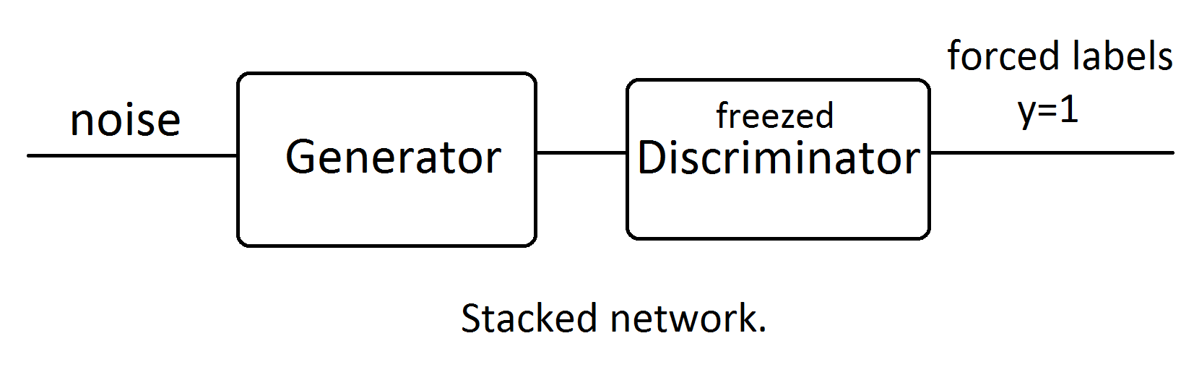
Adversarial Network

Slide 32
Steps for building DCGAN
Build Models
Generator using Convolution Transpose and noise as input
Discriminator with Noise and Real data as input
Adversarial (Generator + Frozen Discriminator)
Training Models
Step 1: Train Discriminator using both Real Data and Fake data from Generator
Step 2 : Train Adversarial Network (indirectly training Generator) using fake data only
Repeat Step 1 and 2 till Generator is producing desired outputs

Slide 33
DCGAN for MNIST in Keras
Notebook!

Slide 34
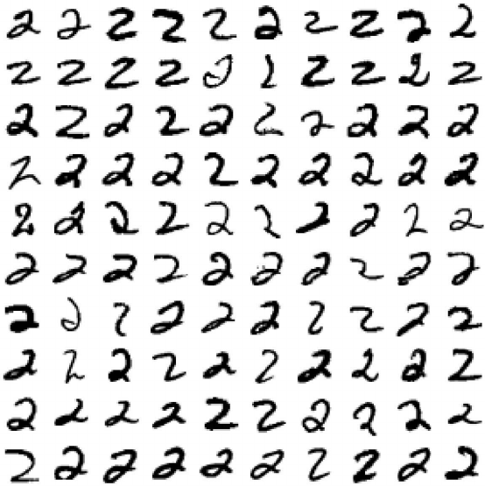
Conditional GANs (CGANs)
What if we only need 2?
Or any other specific number

Slide 35
Conditional GANs
These are GANs that use extra label information.
This results in better quality images and being able to control – to an extent – how generated images will look.

Slide 36
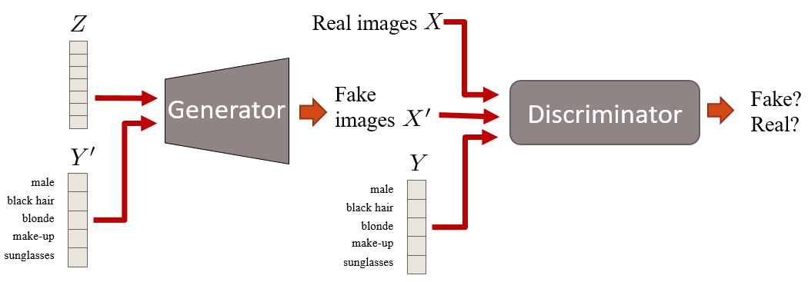
Conditional GANs
Here we have conditional information Y that describes some aspect of the data. For example, if we are dealing with faces, Y could describe attributes such as hair color or gender. Then, this attribute information is inserted in both the generator and the discriminator.

Slide 37
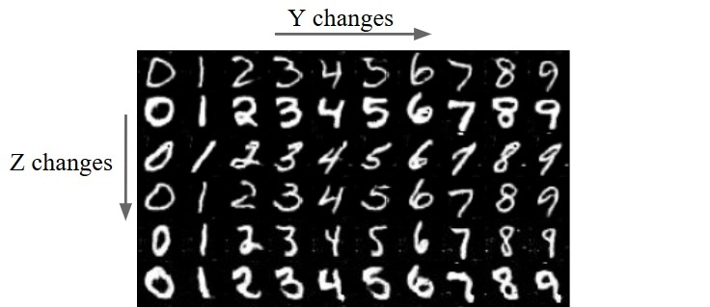
CGANs on MNIST
Differences between Z and
Y on MNIST samples.
Z is fixed on rows and
Y on columns. Z encodes
the style of the number and
Y encodes the number itself.

Slide 38
MNIST Conditional GANs
Notebook!

Slide 39
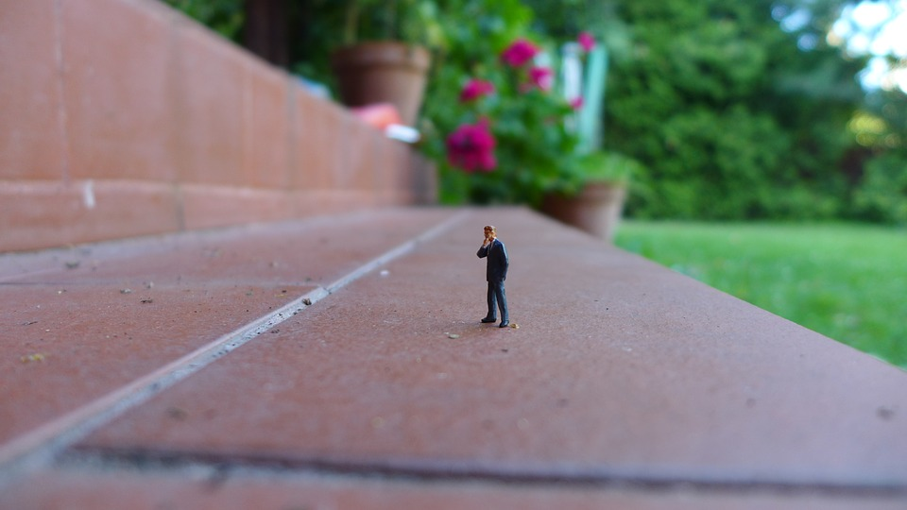
How to train GANs?
Challenges with training GANs -
Vanishing Gradients
Non-convergence
Evaluation Metrics
Mode Collapse (All generator samples
are the same)

Slide 40
Vanishing Gradients
The discriminator gets too successful that the generator gradient vanishes and learns nothing.

Slide 41
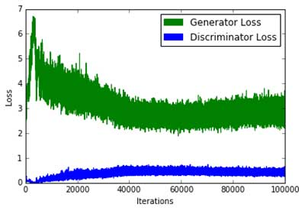
Non-Convergence
The model parameters oscillate, destabilize and never converge.
A common question in GAN training is
“when do we stop training them?”.
Since the Generator loss improves when
the Discriminator loss degrades (and vice
-versa), we can not judge convergence
based on the value of the loss function.
Plot of a typical GAN loss function. Note how convergence cannot be interpreted from this plot. (Source)

Slide 42
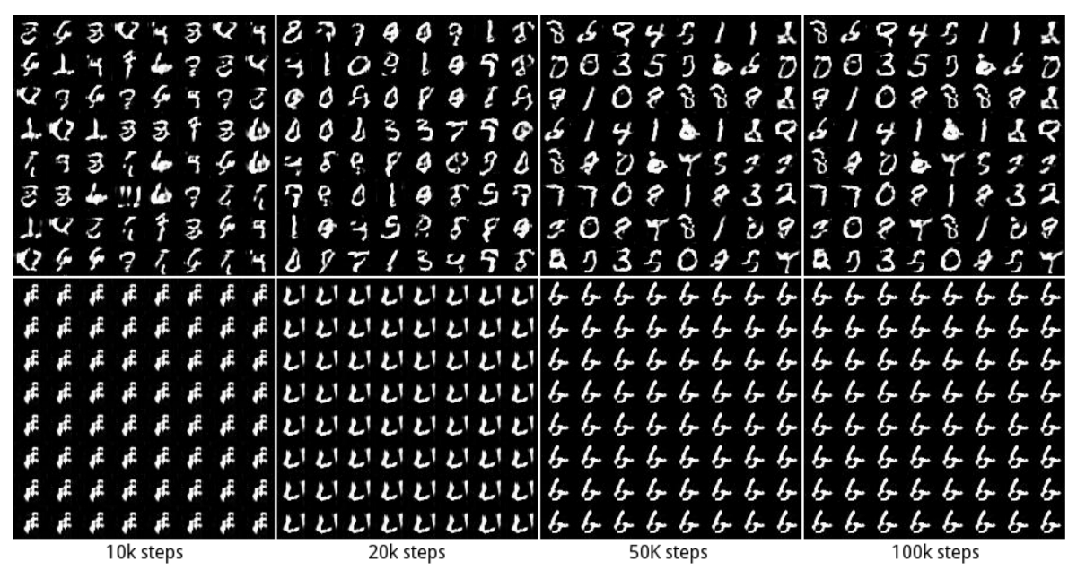
Mode Collapse
Example
In MNIST, there are 10 major modes from digit ‘0’ to digit ‘9’. The samples below are generated by two different GANs. The top row produces all 10 modes while the second row creates a single mode only (the digit “6”).
This problem is called mode collapse when only a few modes of data are generated.
Source https://arxiv.org/pdf/1611.02163.pdf

Slide 43
Evaluation Metrics
It’s hard to measure GANs performance without manually visualizing the output

Slide 44
Some tips for making GANs train
Normalize images between -1 and 1, use tanh as last layer in Generator
Use Gaussian noise and not Uniform
Modified Loss function
Flip labels when training generator
Avoid Sparse Gradients i.e avoid Relu and use LeakyRelu
Use soft and Noisy Labels
Use Adam
Add noise to inputs
Use Dropouts in Generator
This list might not work in all cases and solve the training problems completely.

Slide 45
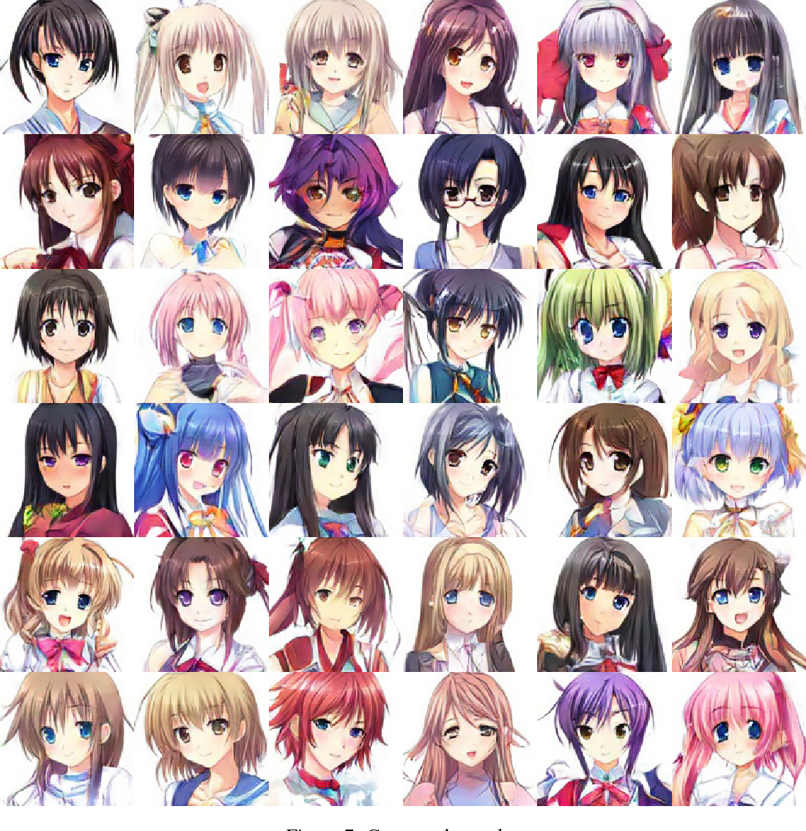
Applications of GANs
Towards the automatic Anime
characters creation
(https://arxiv.org/pdf/1708.05509.pdf)

Slide 46
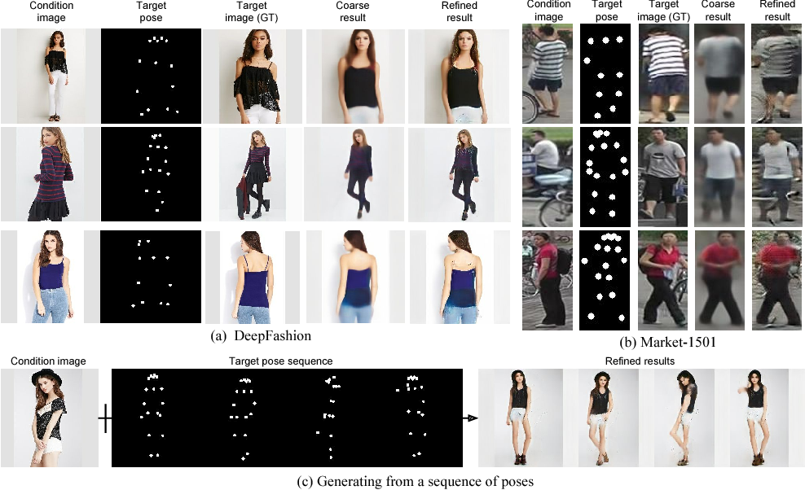
Pose Guided Person Image Generation
https://papers.nips.cc/paper/6644-pose-guided-person-image-generation.pdf

Slide 47
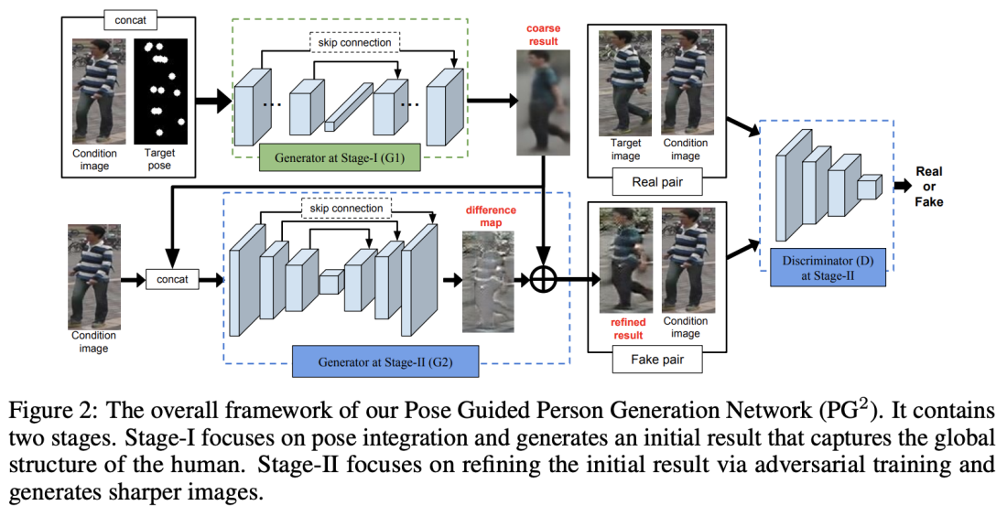
Pose Guided Person Image Generation

Slide 48
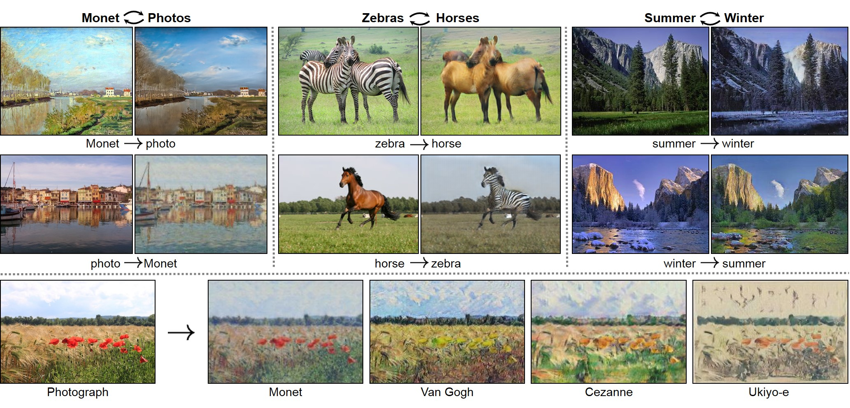
Cycle GANs
Unpaired Image-to-Image
Translation using Cycle-Consistent
Adversarial Networks
(https://github.com/junyanz/CycleGAN)

Slide 49
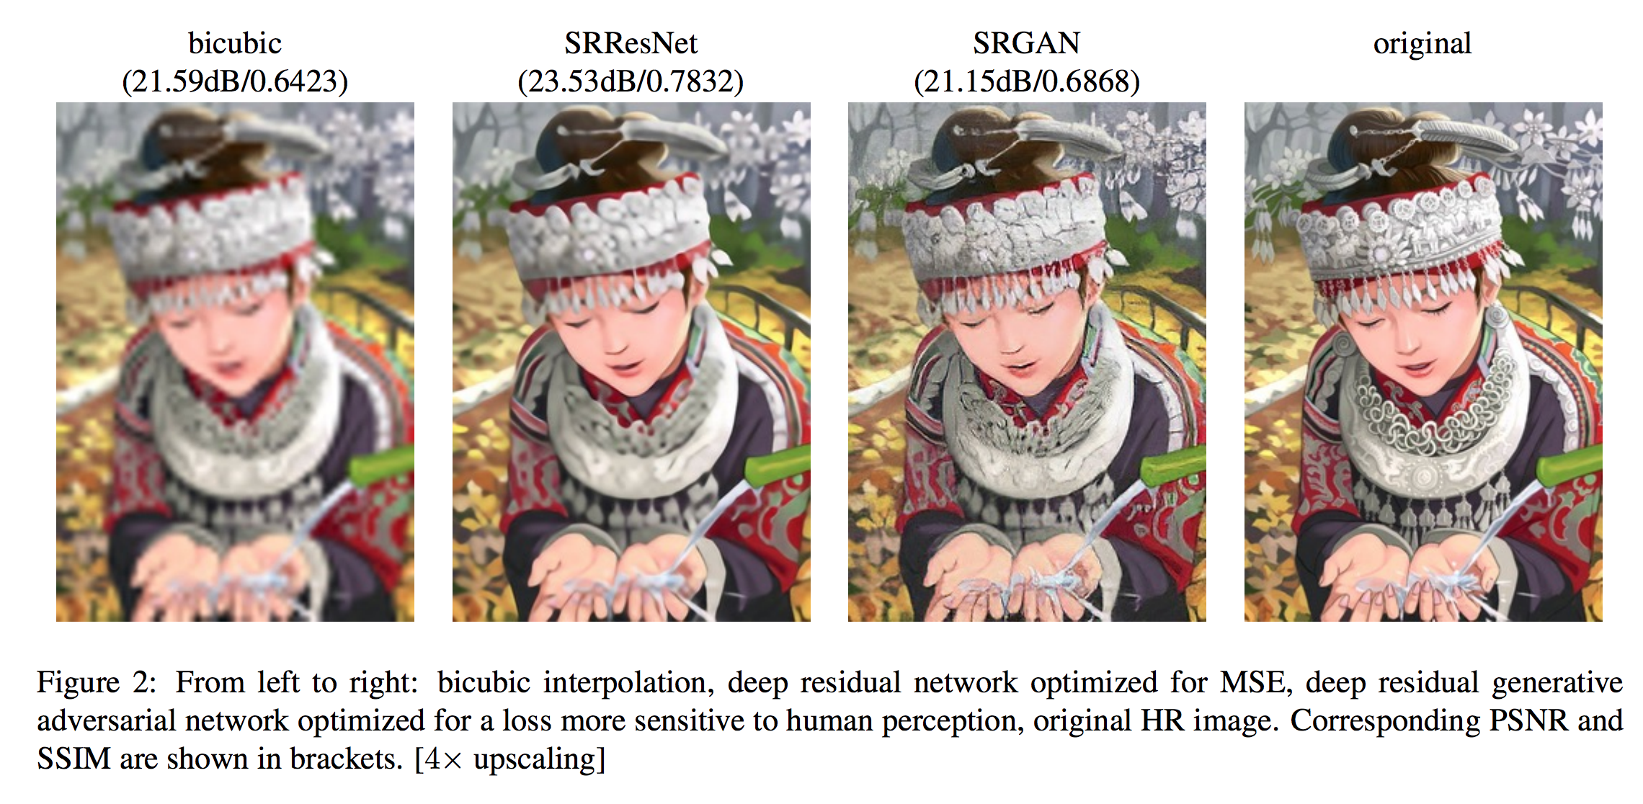
Super Resolution GAN (SRGAN)
https://arxiv.org/pdf/1609.04802.pdf

Slide 50
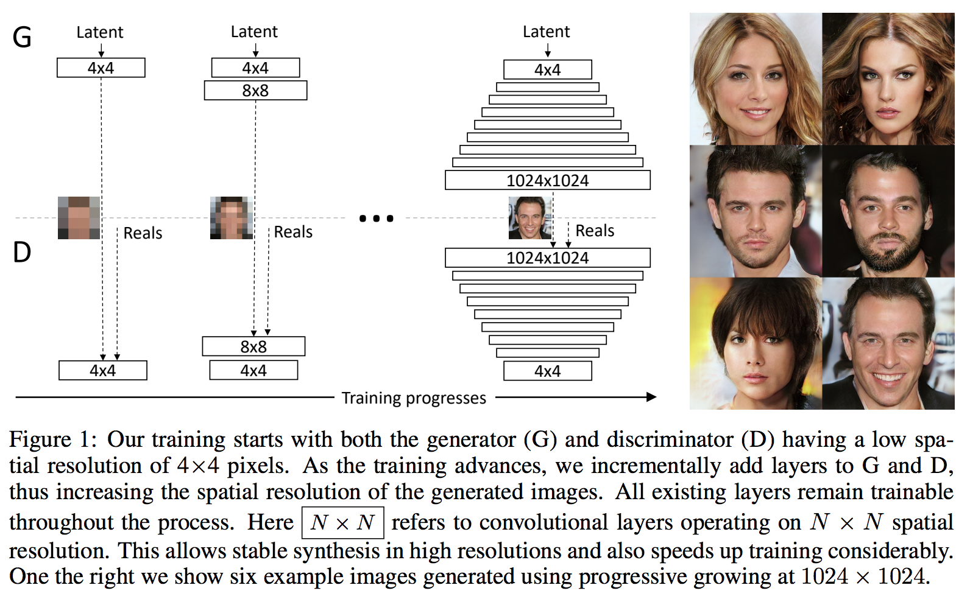
Progressive GANs
https://arxiv.org/pdf/1710.10196.pdf

Slide 51
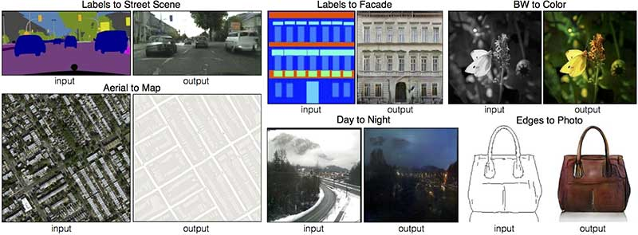
Image translation using GANs
Source - https://phillipi.github.io/pix2pix/

Slide 52
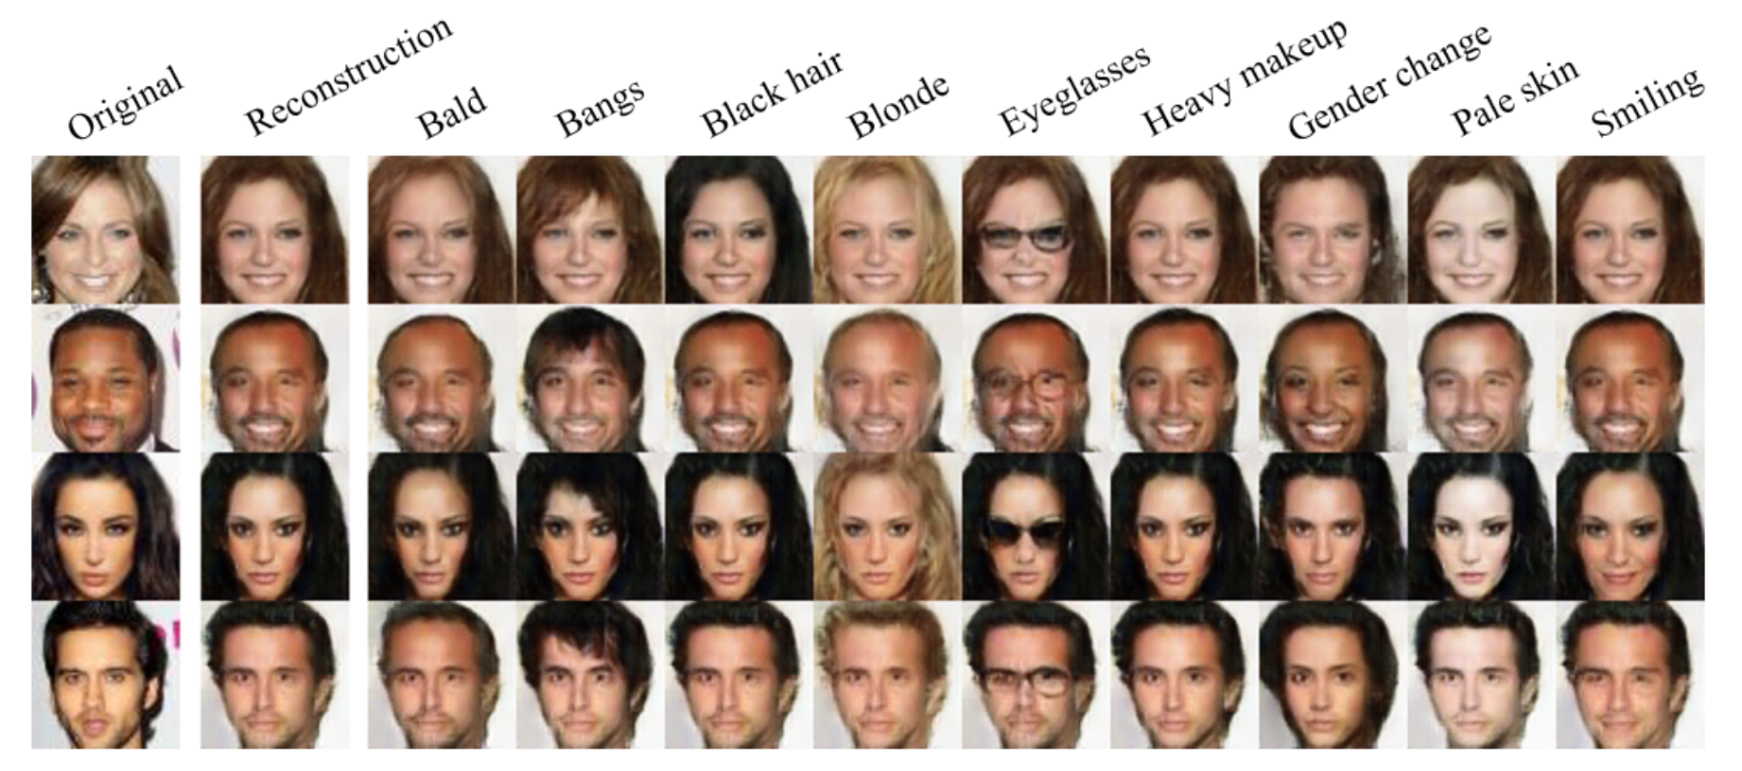
Reconstruct or edit images with specific attributes
IcGANs
https://github.com/Guim3/IcGAN

Slide 53
Some more Applications
Video Generation- https://www.youtube.com/watch?v=Pt1W_v-yQhw&feature=youtu.be
Generate 3D Objects - 3DGAN https://www.youtube.com/watch?v=HO1LYJb818Q&feature=youtu.be
Music Generation - MidiNet - https://arxiv.org/pdf/1703.10847.pdf
The GAN Zoo- https://github.com/hindupuravinash/the-gan-zoo

Slide 54
Questions?
What is Supervised Learning?
What is Unsupervised Learning?
What is Semi-Supervised Learning?
Label a small set of data
Use lots of unlabeled Data
Train machine model

Slide 55
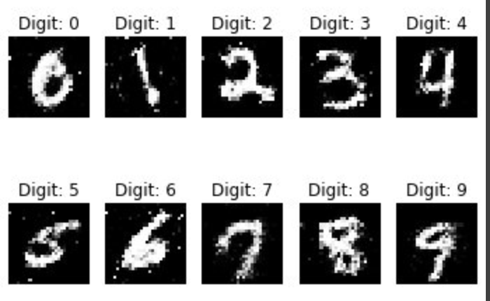
Data for Semi-Supervised Learning
1. Use small set e.g. 1.5% of Training images with
Labels
2. Remaining training data (98.5%) will be used
without Labels
3. Model will be validated using 10,000 images
from Test Data

Slide 56
Semi-Supervised Learning with GANs
Real data with no labels
Real data with labels
Discriminator
Fake or real
Generator
Noise
Binary Classification??
No!!
Its a multilabel classification
Fake data with no labels

Slide 57
Multilabel Classification?
Real or Fake?
Probability of a number (0,1,2,3…..9)

Slide 58
How do we train?
Real data with no labels
Loss for real or Fake
Real data with labels
Loss for MNIST Classification(0 to9)
Discriminator
Generator
Noise
Loss for generator
Fake data with no labels

Slide 59
How do we train?
Real data with no labels
optimizer
Loss for real or Fake
Real data with labels
Loss for MNIST Classification(0 to9)
Discriminator
Generator
Noise
Loss for generator
Fake data with no labels
optimizer

Slide 60
Losses
Binary Classification (Real or Fake) - Binary Cross Entropy
Loss for MNIST Classification - Categorical Cross Entropy
Loss for Generator - Binary Cross Entropy

Slide 61
Semi-Supervised Learning in tensorflow
Notebook!

Slide 62
Additional Resources
GANs Playground - https://reiinakano.github.io/gan-playground/
GANs Comparision - https://github.com/khanrc/tf.gans-comparison

Slide 63
References
https://jjallaire.github.io/deep-learning-with-r-notebooks/notebooks/8.5-introduction-to-gans.nb.html
https://medium.com/randomai/gan-for-medical-imaging-generating-images-and-annotations-8ad7c778809c
https://medium.com/randomai/gan-for-medical-imaging-generating-images-and-annotations-8ad7c778809c
https://towardsdatascience.com/gan-by-example-using-keras-on-tensorflow-backend-1a6d515a60d0
https://medium.com/apache-mxnet/transposed-convolutions-explained-with-ms-excel-52d13030c7e8
https://medium.com/@sharimpervez/a-simple-introduction-to-generative-adversarial-networks-gans-8e327ff65f7c
http://guimperarnau.com/blog/2017/03/Fantastic-GANs-and-where-to-find-them
https://www.topbots.com/advances-in-gans/
https://medium.com/@jonathan_hui/gan-progressive-growing-of-gans-f9e4f91edf33

